Slide 1
Monroe Musicians
I have missed you. I love listening to you singing.
Keep singing and dancing while we are keeping a safe distance from each other.
We have been studying the instruments of the Orchestra. Below you will find an assignment for next weeks music adventure.

Slide 2
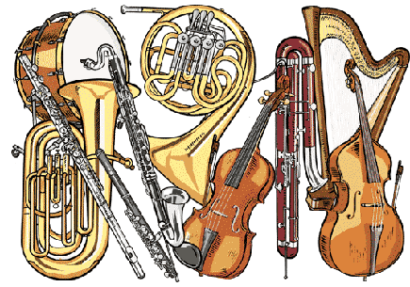
This Photo by Unknown Author is licensed under CC BY-SA-NC
This Photo by Unknown Author is licensed under CC BY-SA-NC
This Photo by Unknown Author is licensed under CC BY-SA-NC
This Photo by Unknown Author is licensed under CC BY-SA-NC

Slide 3
The Dallas Symphony Organization provides young musicians with activities through their program DSOKids. This week I would like you to explore the section titled Listen and Learn. I would like to challenge you to fill out a SQUILT Journal for at least one of your listening experiences.
Notes:
The Dallas Symphony Organization provides young musicians with activities through their program DSOKids. This week I would like you to explore the section titled Listen and Learn. I would like to challenge you to fill out a SQUILT Journal for at least one of your listening experiences.

Slide 4
Listening
https://www.mydso.com/dso-kids/learn-and-listen/instruments
This Photo by Unknown Author is licensed under CC BY-SA

